Slide 1

Typhoon’s feature in different stage
Dealing with satellite image data
Kuizheng Chang 45993345
Weigai He 45411728
Xi Cheng 45993345
Ziqing Yan 45551781

Slide 2
Goal and focus
1.Try different ML algorithms to classify typhoon images and compare their performance.
2. Reduce the dimension of our data for improving the calculation speed.
3. Hopefully we can find enough features for typhoon warning.

Slide 3
significance
1. Assist meteorologists to process meteorological graphics with computer. The picture from satellite is difficult to fit in ML algorithms, this work is a good try.
2. Using classification processing the pictures to doing prediction, could be used to help people adjust their activities. The prediction of typhoon is very important, helping people save their life or city control loss.
3.Help us understand typhoon, getting knowledge about the feature of typhoon in different stages.

Slide 4
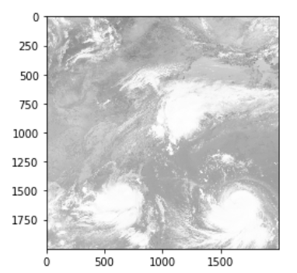
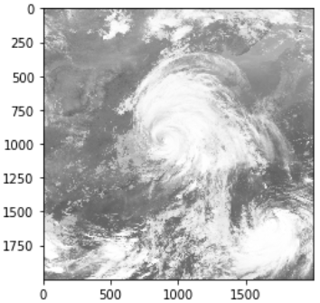
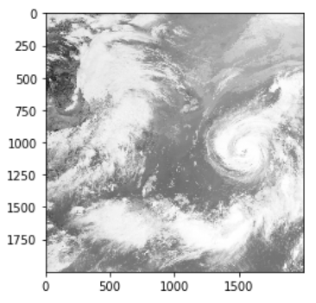
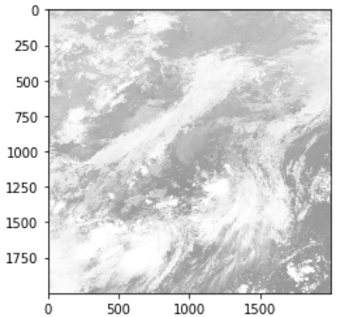
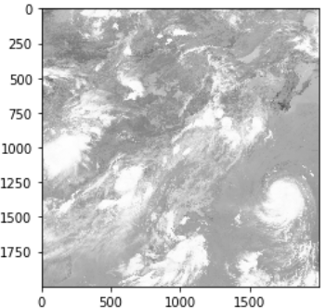
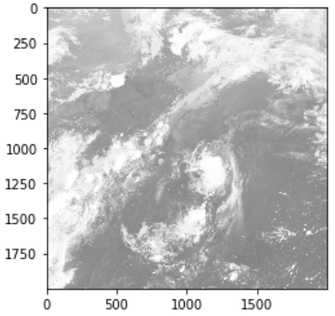
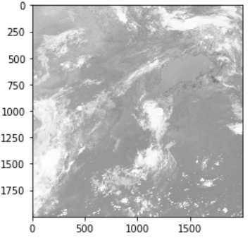
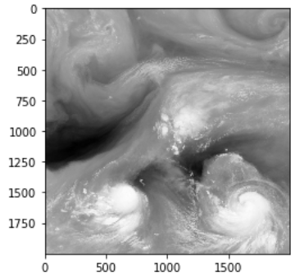
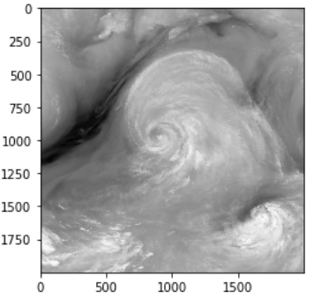
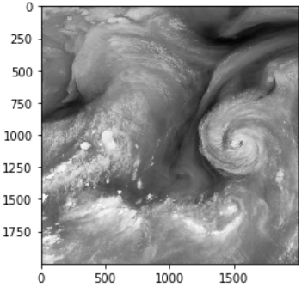
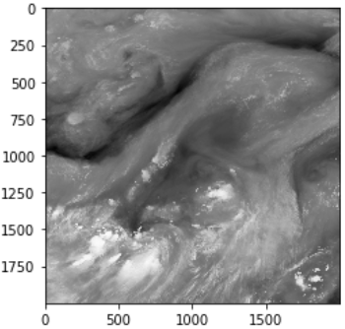
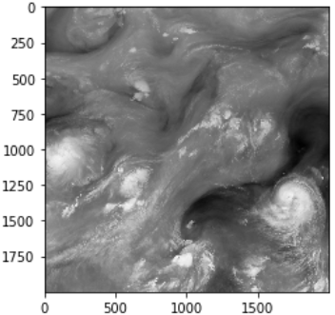
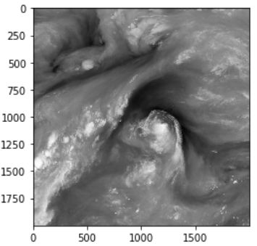
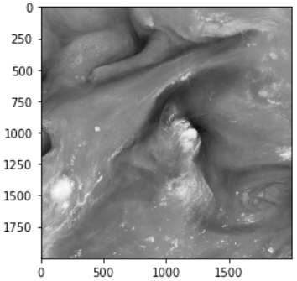
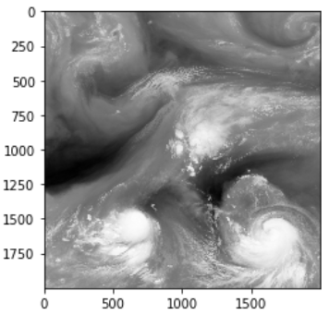
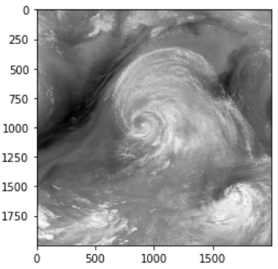
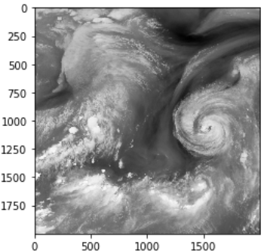
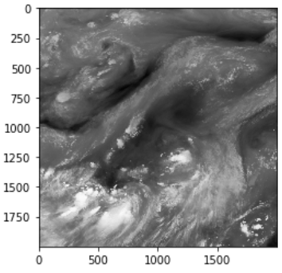
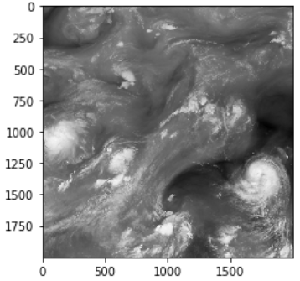
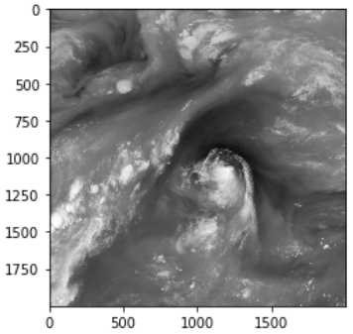
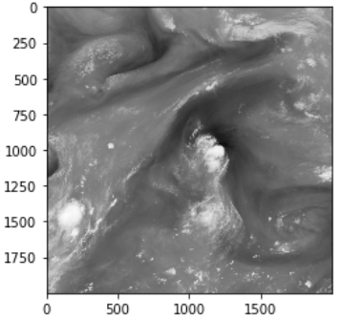
Dataset Introduction
In chronological order(550 hour)
hour
146
253
347
425
506
597
655
Bond_08
Bond_09
Bond_10

Slide 5
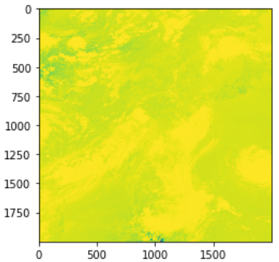
Data filter
Bond_8
Bond_9
Bond_10
Change to fast, it’s hard to label picture, and hard to describe the change
Change not so fast and clearly show the momentum of atmosphere in different stage.
Change slowly, although it could show the momentum of atmosphere, but not obvious(compare with bond-9
No outlier, every picture is very clear
No outlier, every picture is very clear
outlier
We decide to use bond 9 as data resource

Slide 6
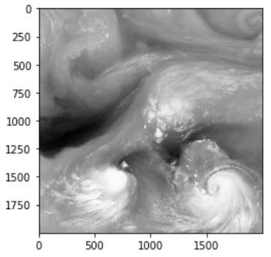
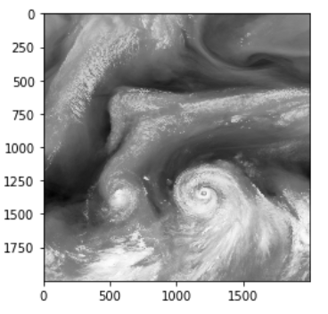
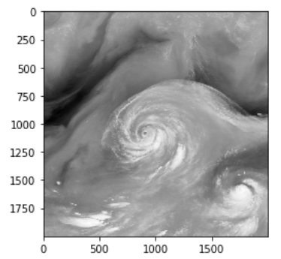
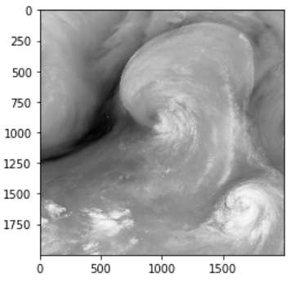
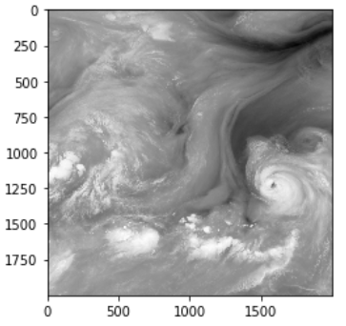
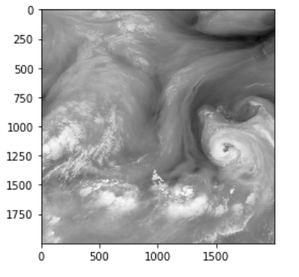
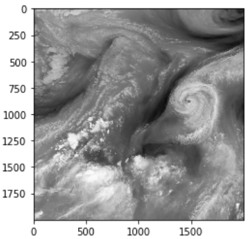
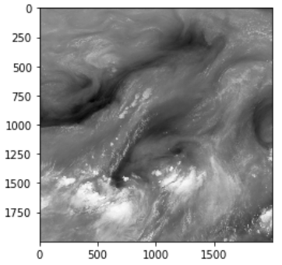
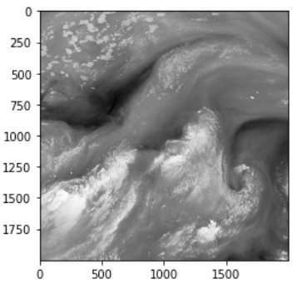
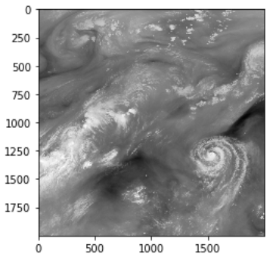
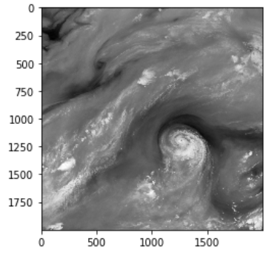
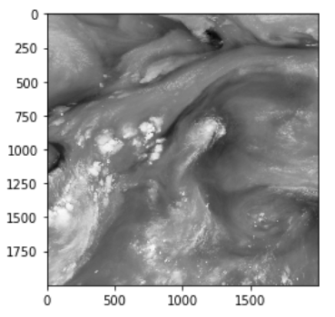
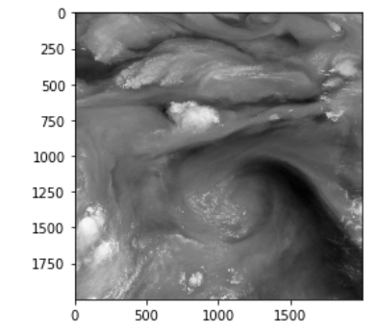
Label the data resource
Depends on whether the air passage is connected or not
Location of cyclone
These plot come from a satellite research institute, so it haven’t been attached label, so we divide these picture into different category.
Label 1
Label 2
Label 3
Label 4
Label 5
Label 6
Label 7
Label 8
Label 9
Label 10
Label 11
Label 12
Label 13

Slide 7
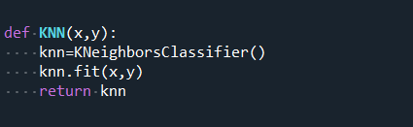
KNN
Using knn from sklearn.x

Slide 8
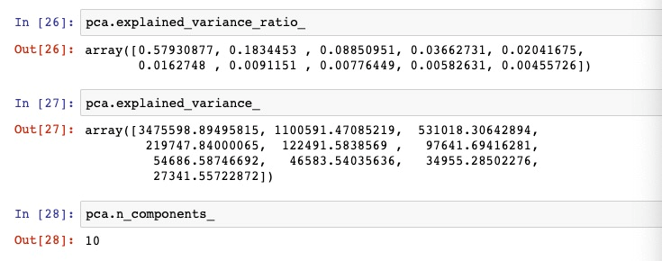
PCA
Using pca from sklearn,set n_components=10

Slide 9
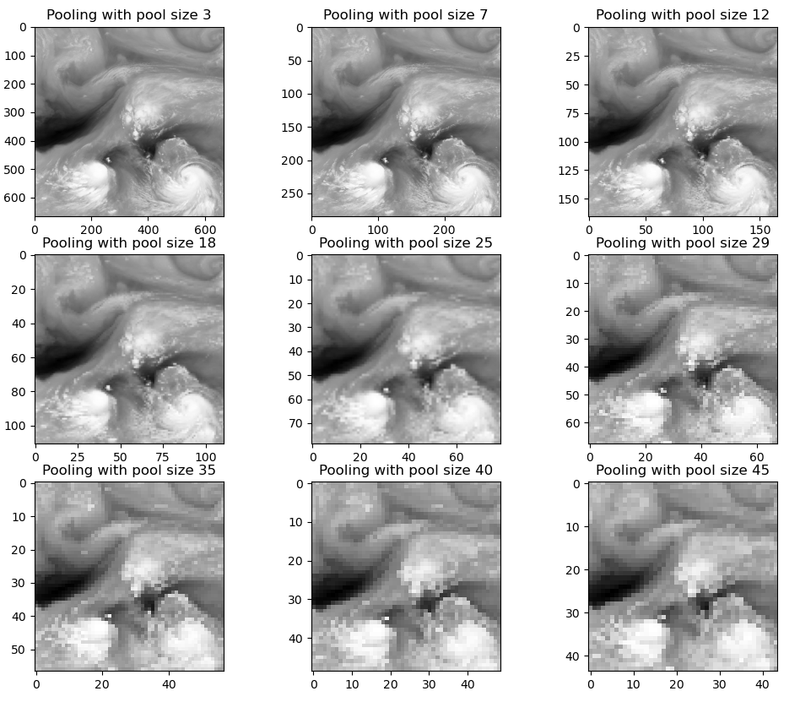

Convolution
(I) Pooling
Max-pooling
Average-pooling
$$\left[\begin{matrix}1 & 1 & 1 \\ 1 & 1 & 1 \\ 1 & 1 & 1\end{matrix}\right]×\frac{1}{9}$$
Filter:

Slide 10
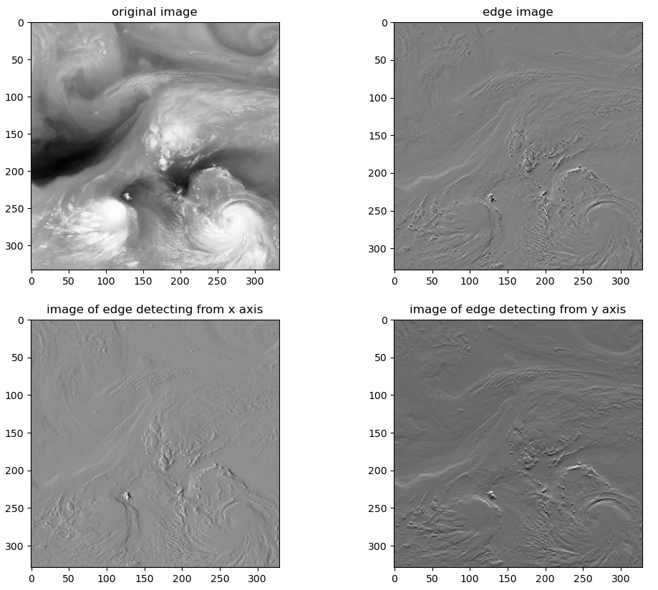


Convolution
(II) Edge detection
$$\left[\begin{matrix}−1 & 0 & 1 \\ −2 & 0 & 2 \\ −1 & 0 & 1\end{matrix}\right]×\frac{1}{2}$$
X axis:
$$\left[\begin{matrix}−1 & −2 & −1 \\ 0 & 0 & 0 \\ 1 & 2 & 1\end{matrix}\right]×\frac{1}{2}$$
Y axis:

Slide 11
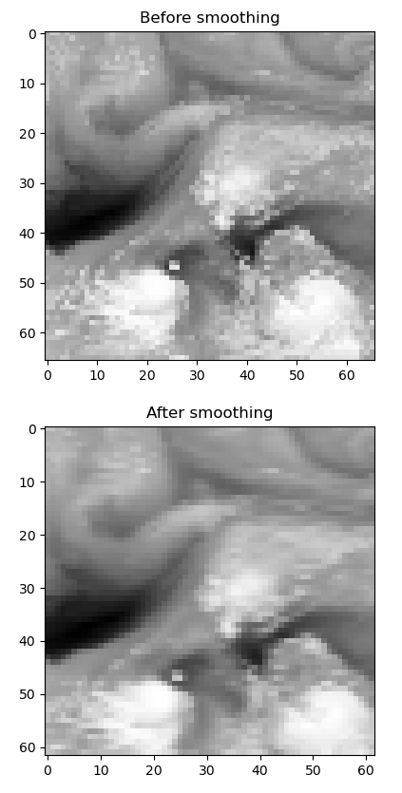

Convolution
(III) Smoothing
$$\left[\begin{matrix}1 & 2 & 1 \\ 2 & 8 & 2 \\ 1 & 2 & 1\end{matrix}\right]×\frac{1}{20}$$
Filter:

Slide 12
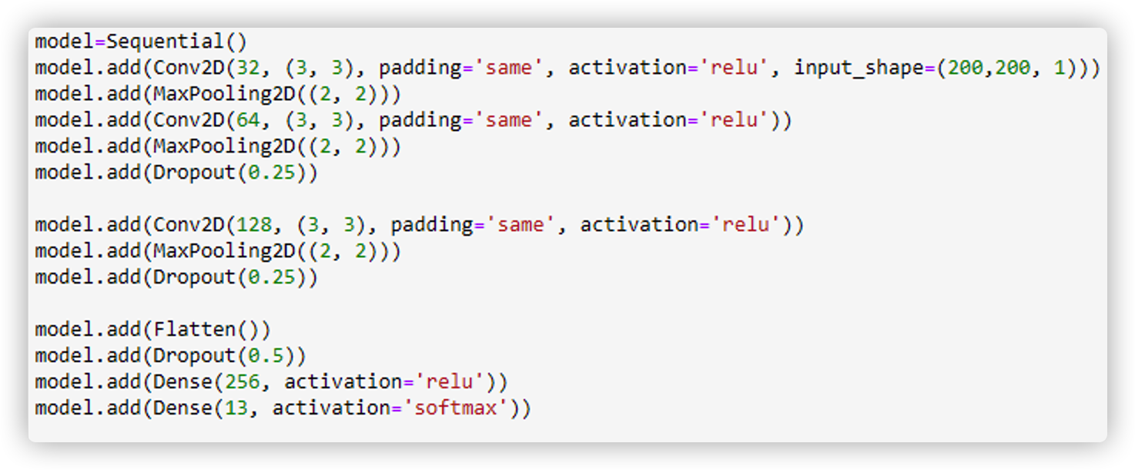
CNN classifier - building model
Here is the CNN model, using Keras in tensorflow.

Slide 13
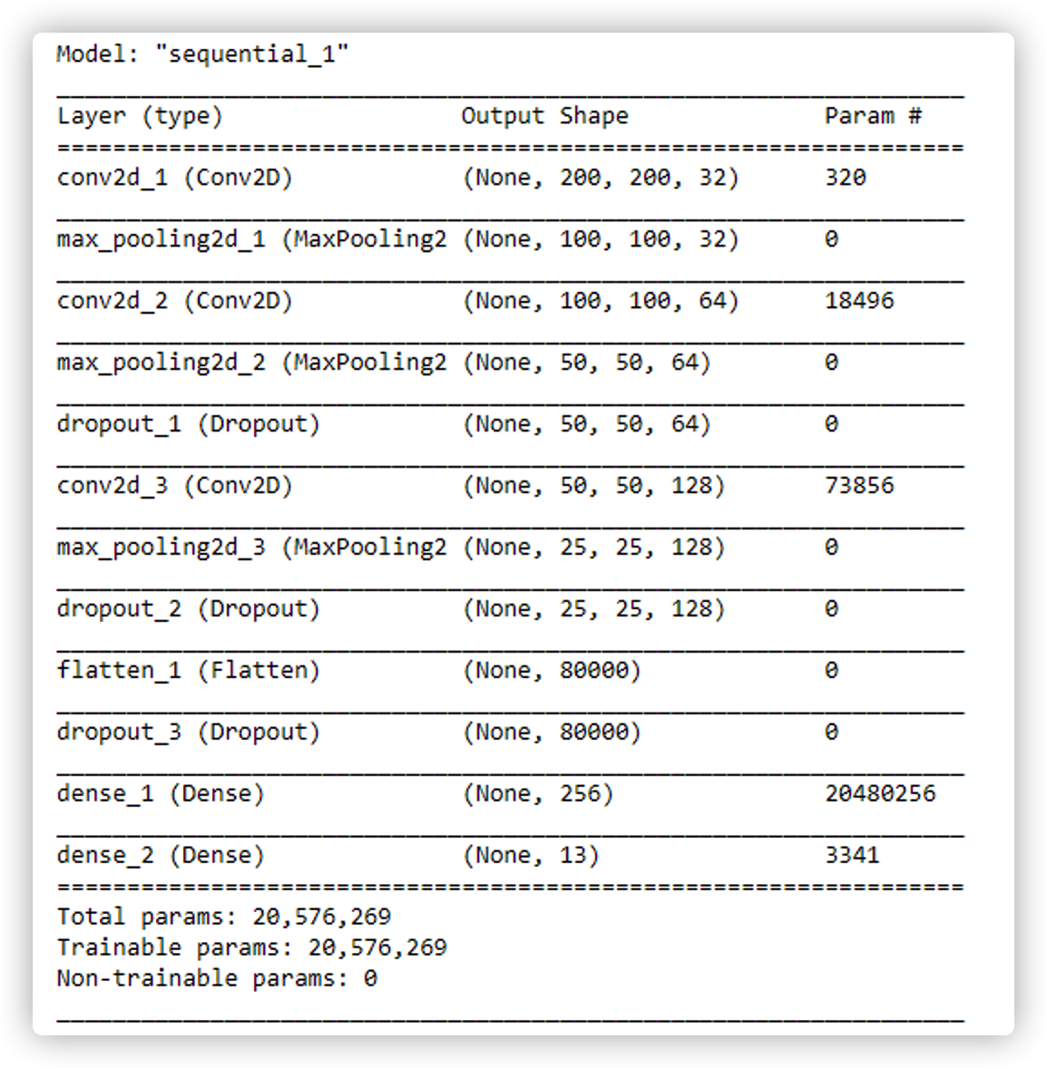
CNN classifier - building model

Slide 14
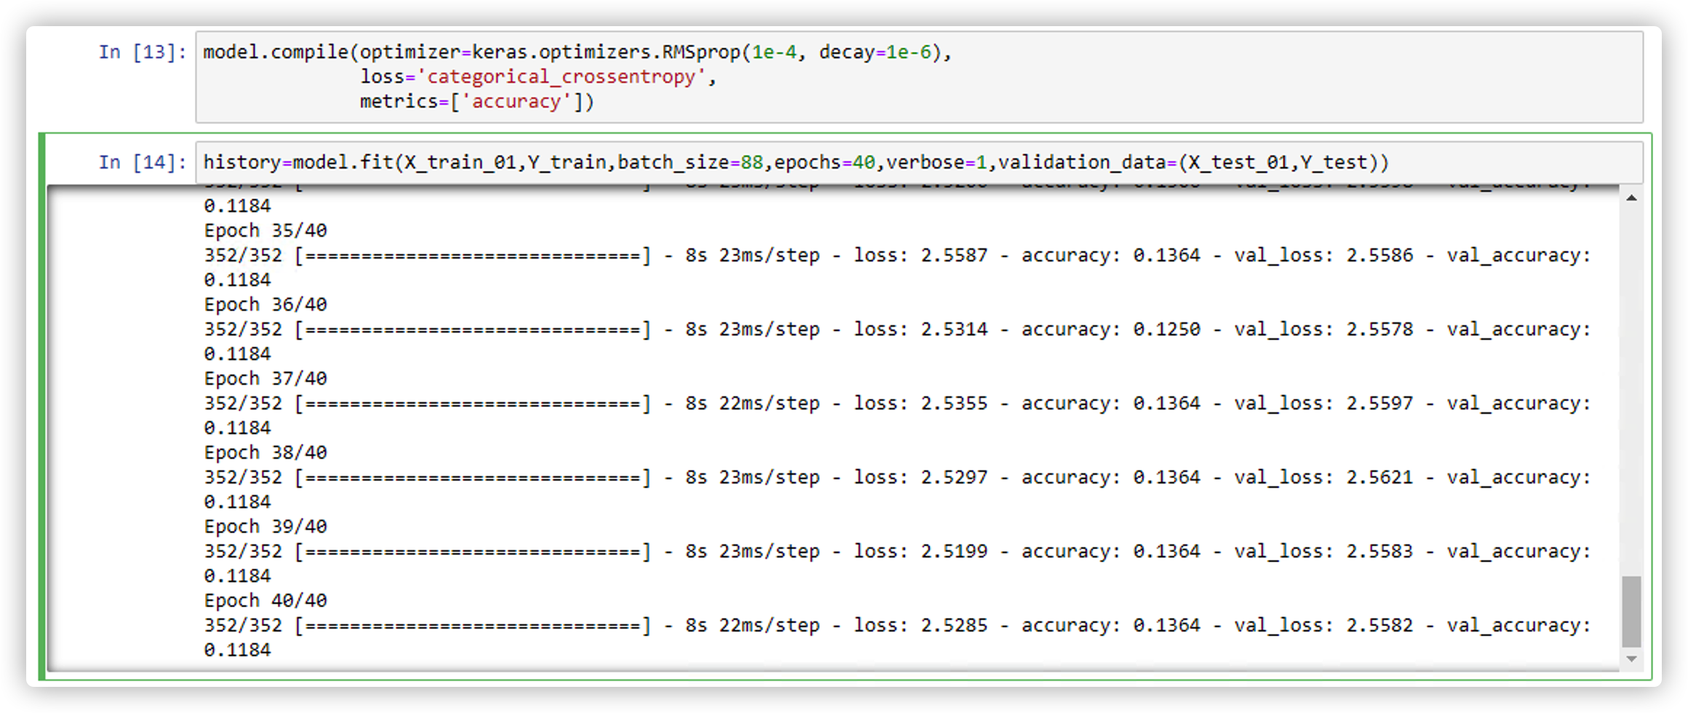
CNN classifier - building model
Compiling the model with learning rate = 1e-4, loss = 'categorical_crossentropy'
Fitting the model with batch_size = 88, epochs = 40

Slide 15
Further improvements
1. Run our algorithm on larger data set and improve our accuracy.
2. This data set can also be considered as a time series, and additional works could be done for predicting the variation trend of the image.
3.Based on what we have done above,try performing unsupervised learning (KNN) on dataset to see the accuracy

Slide 16
Thanks
Q&A

